Slide 1
ChatBot Music Recommendation System
Team Details
1.G Keerteshwar Reddy(20EG105410)
2.Mahesh Pawar(20EG105424)
3.Akhil D(20EG105716)
Project Supervisor:
E.Radhakrishnaiah

Slide 2
Introduction
The proposed system work develops a personalized system, where the user's current emotion is analyzed with the help of the chat bot.
The chat bot identifies the user's sentiment by chat conversation with the user.
Based on the input provided by the user, currentemotion or mood is analyzed by the chat bot and it will suggest song to the user.
The objective of our application is to identify the mood expressed by the user and once the mood is identified, songs are played by the application.
The application solves the basic needs of music listeners without troubling them as existing applications do.
Environment developed are Interactive Chat Bot, Interactive System User Interface, Recommender System, MYSQL Server,Natural Language Processing, Sentimental Analysis.

Slide 3
Problem Statement
Recommendation of Music to the users based on their emotions during conversation or a word with a chatbot using Machine learning and Natural Language Processing.
The primary objectives of such a system are Personalization,Discovery,User Interaction,User Satisfaction.
Parameters are based on User Profile,Music Metadata,Collaborative Filtering,Content-Based Filtering,Recommendation Algorithms.

Slide 4
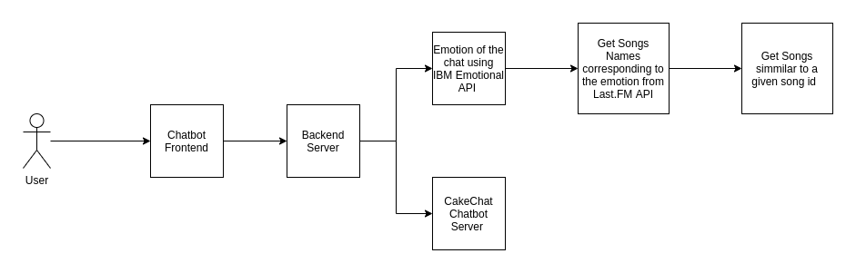
Proposed Method

Slide 5
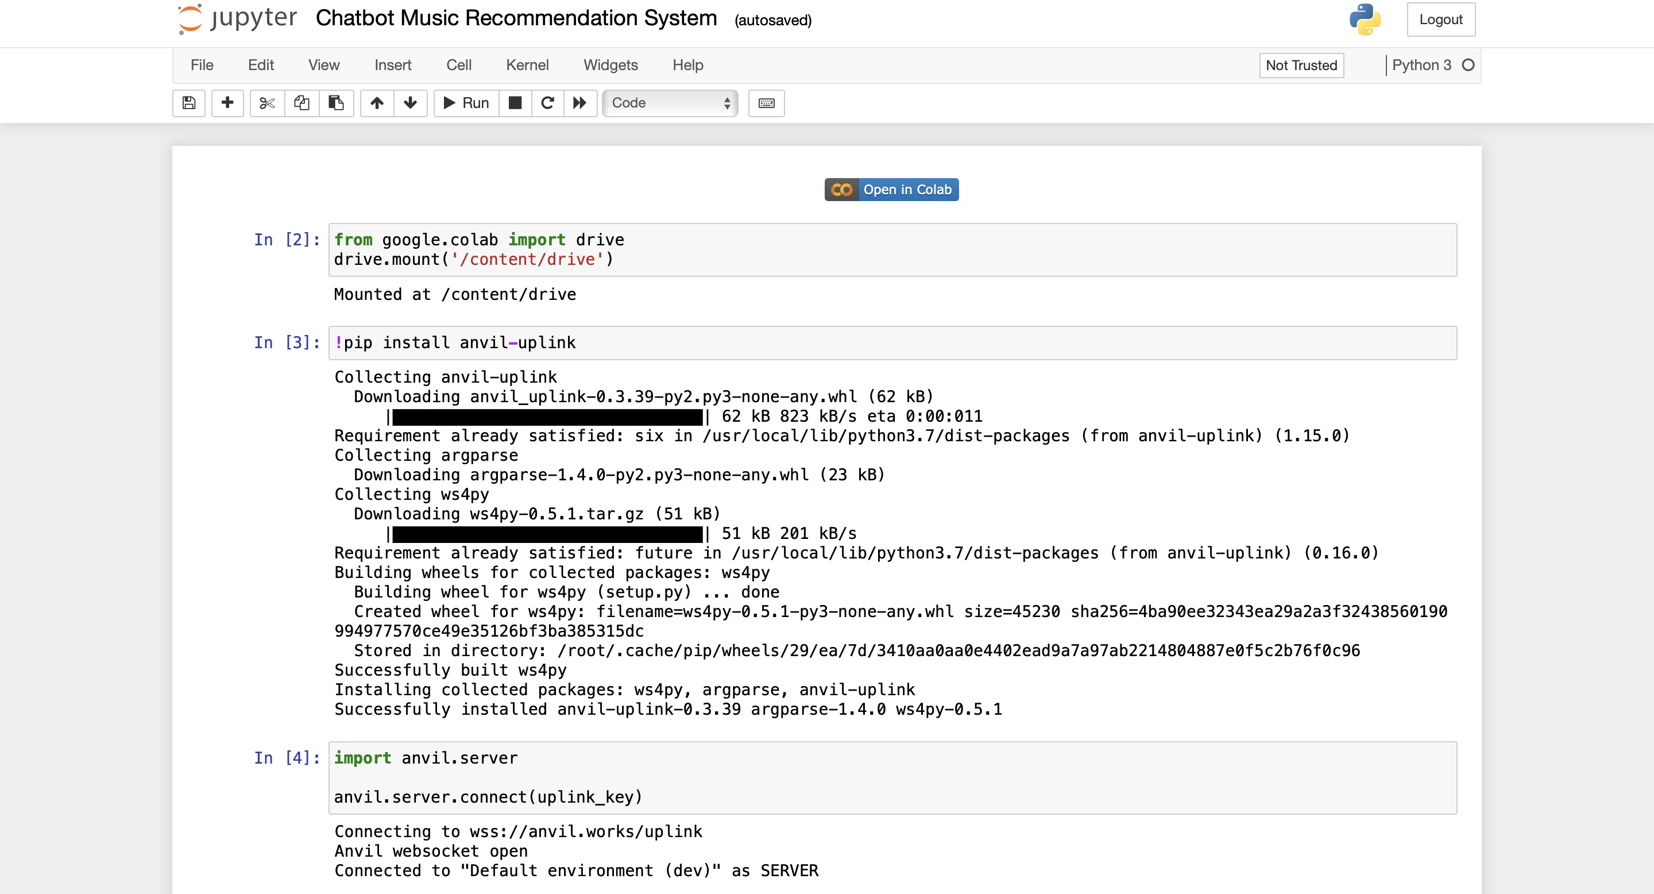
Experiment Environment
Experiment Environment used is IDLE and Jupyter Notebook-Python

Slide 6
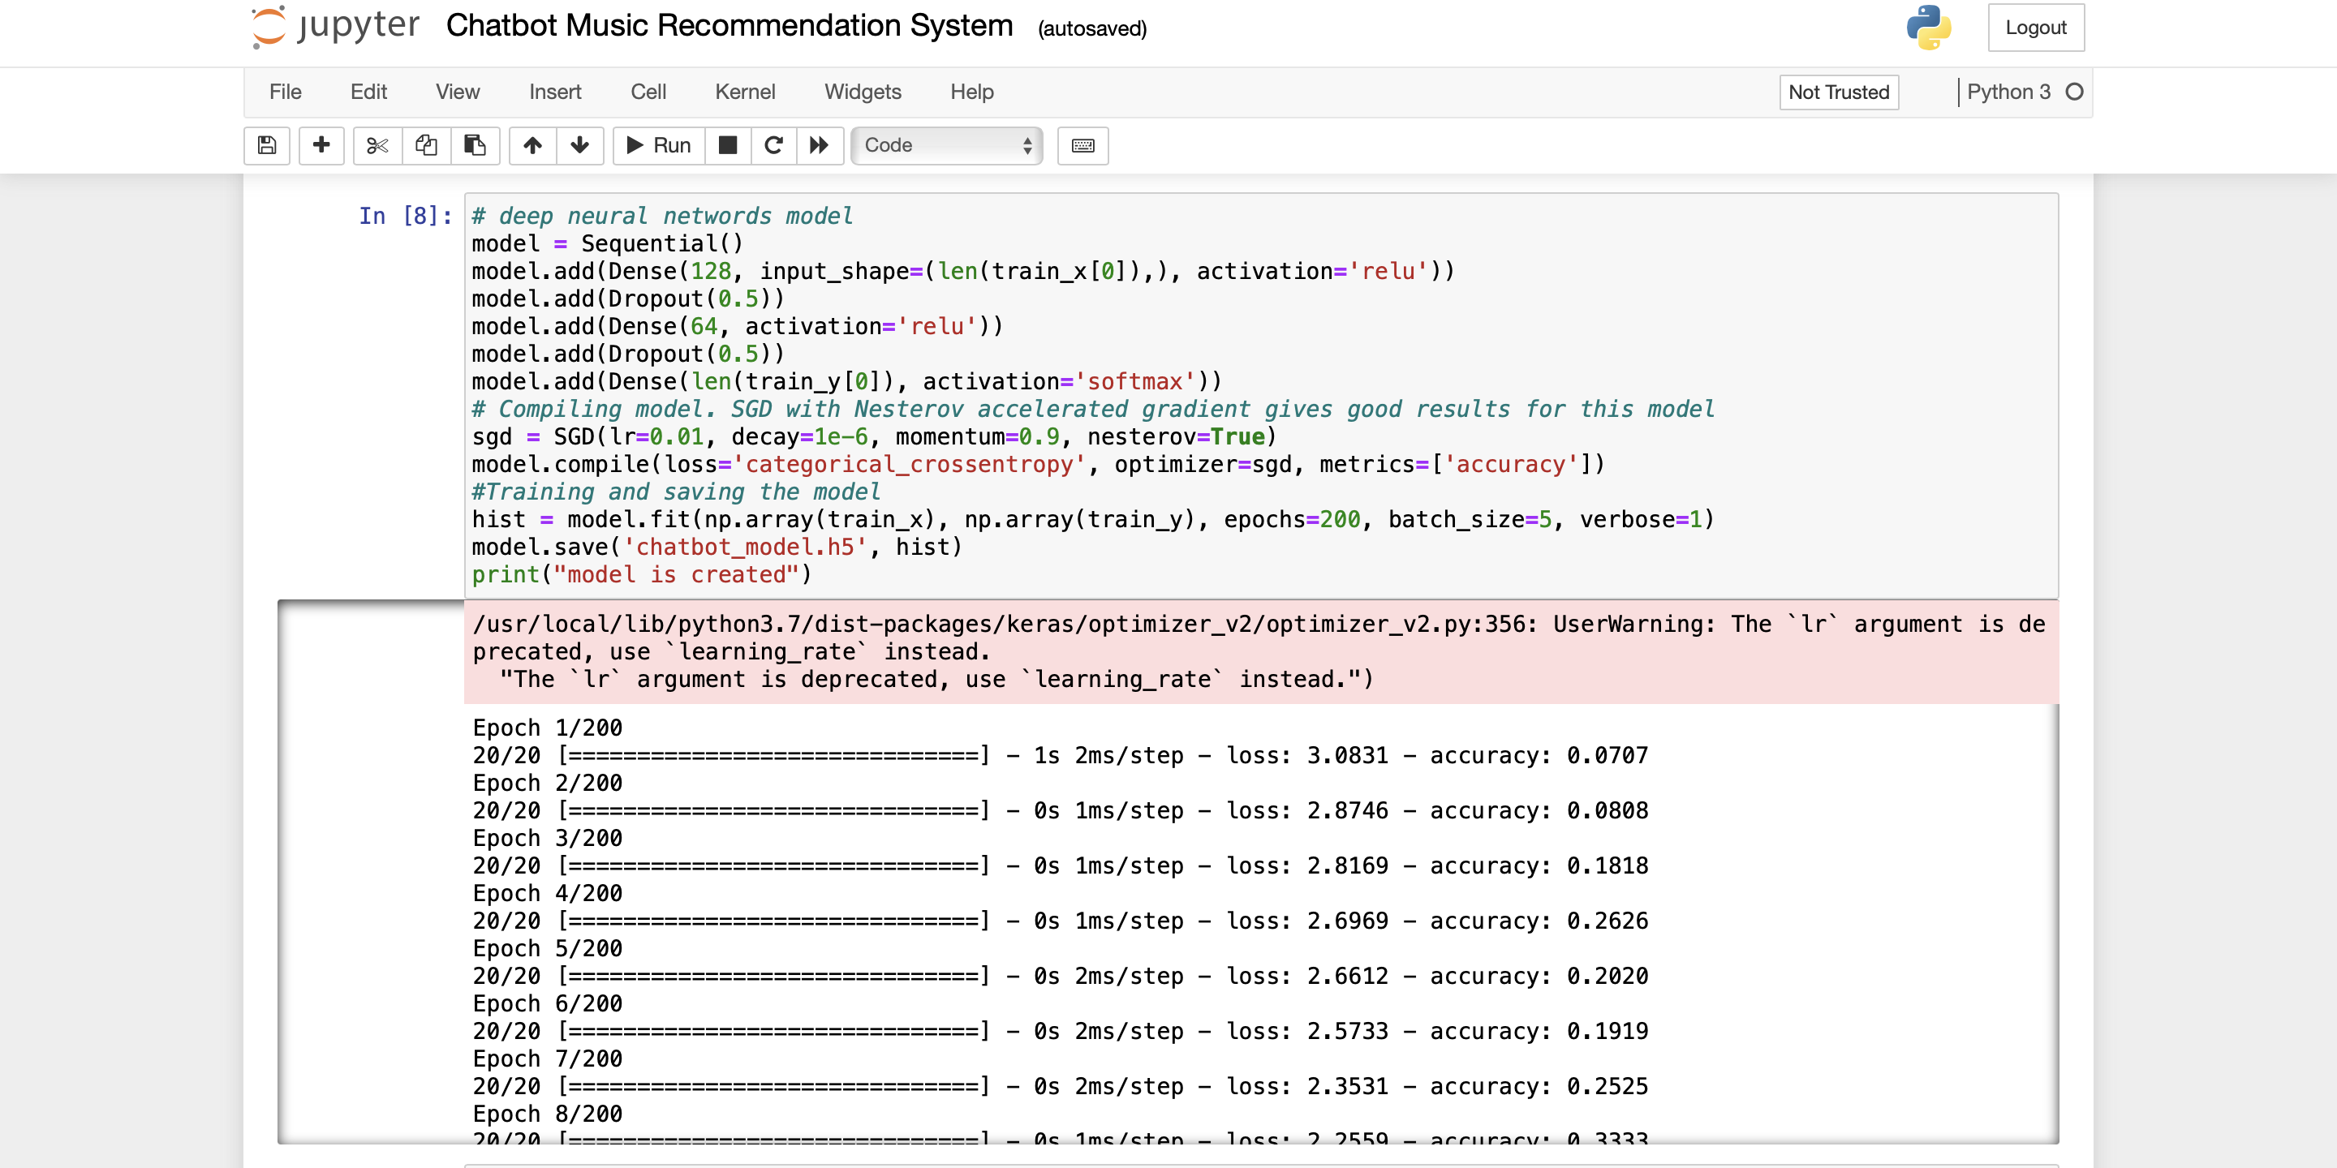
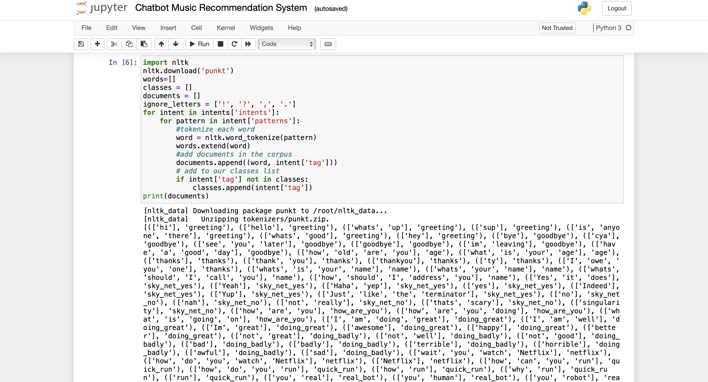
Experiment Screen shorts

Slide 7
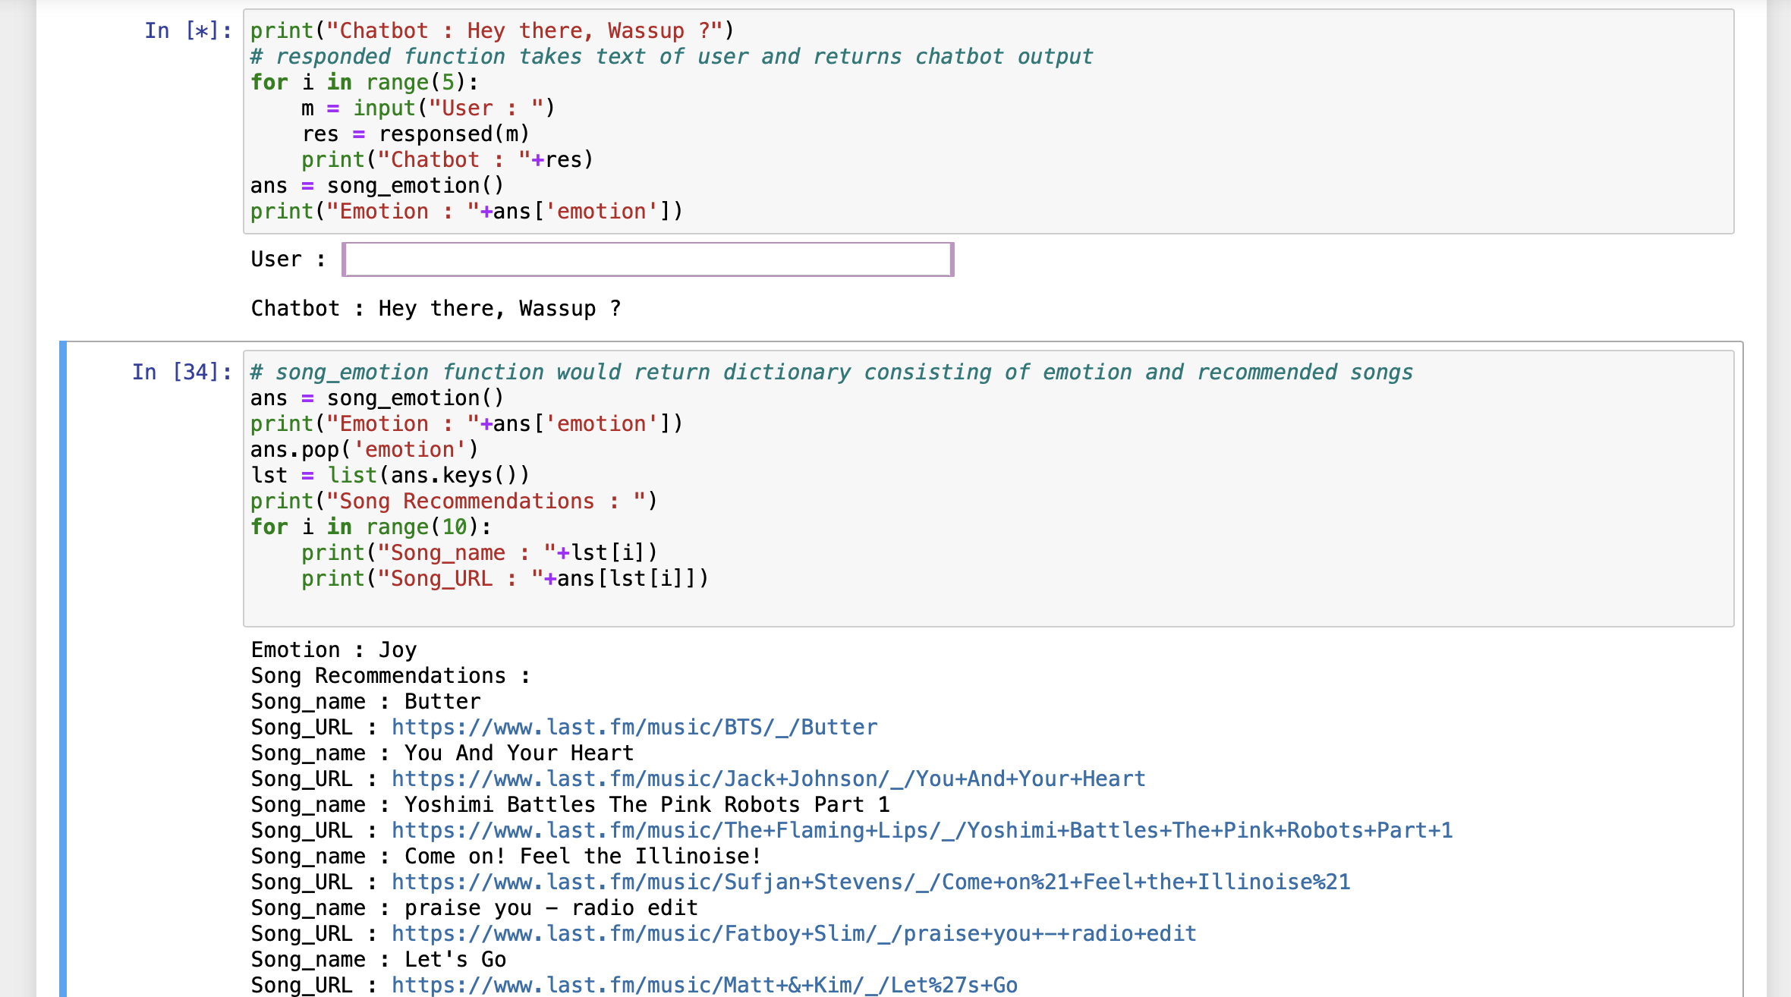
Experiment Results

Slide 8
Findings
Personalized Music Recommendations: Chatbot music recommendation systems use algorithms and user data to provide highly personalized music suggestions. The findings may indicate that users are more likely to engage with and enjoy music when the recommendations align with their musical preferences.
User Engagement: The system may observe increased user engagement when music recommendations are delivered through a chatbot. The conversational nature of chatbots can enhance the user experience and encourage users to explore new music.
Cold-Start problems and the results are Reinforced and Multi-level Collabroative and Context based filterings are used.

Slide 9
Justification
Sl. No | Parameter | Existing value | Improved value | Justification
1. | Recommendati-on accuracy | Around 45% | Upto 67% | Improving the accuracy ensures high related playlists to the emotion.
2. | Response time | 6-7 secs | 3 secs | Fast enhanced results.
3. | Personalisation Level | low | High | Aligned with User’s mood more accurately.

Slide 10
THANK YOU

